Slide 1
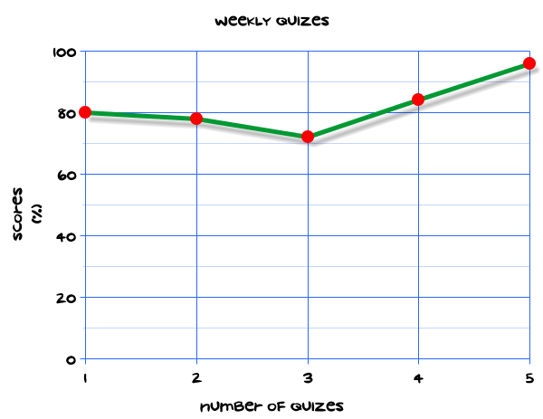
My Statistics Interactive Notebook
Name
Class
Teacher
Term 1 Semester 1
1

Slide 2
Create your own front page
It needs to contain the following –
My number interactive notebook
Name
Class
Teachers Name
Semester 1 Term 1
Page number 1

Slide 3
Contents
Glossary or Formula Page
Page
Date
Description
2
3

Slide 4
Tasks
24
7
30
Essential Question
Questions
Notes
Summary
4
5

Slide 5
24
7
30
Date
Title
EQ –
5

Slide 6
24
7
30
Date
Representing Data
EQ – How can I calculate averages from a stem and leaf diagrams?
5

Slide 7
24
7
30
Date
Representing Data
EQ – How can I calculate averages from a stem and leaf diagrams?
What is a stem and leaf diagram?
5

Slide 8
24
7
30
Date
Representing Data
EQ – How can I calculate averages stem and leaf diagrams?
What is a stem and leaf diagram?
A stem and leaf diagram a method for representing data lists all the values in a data set in order
5

Slide 9
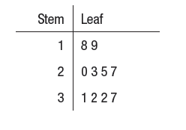
24
7
30
Date
Representing Data
EQ – How can I calculate averages stem and leaf diagrams?
What is a stem and leaf diagram?
A stem and leaf diagram a method for representing data lists all the values in a data set in order
This shows the ages of the members of a cricket
Key 2|3 = 23
5

Slide 10
24
7
30
Date
Representing Data
EQ – How can I calculate averages from a stem and leaf diagrams?
What is a stem and leaf diagram?
A stem and leaf diagram a method for representing data lists all the values in a data set in order
This shows the ages of the members of a cricket
Key 2|3 = 23
Don’t forget to write a key to show the values of the data set
5

Slide 11
24
7
30
Date
Representing Data
EQ – How can I calculate averages from a stem and leaf diagrams?
What is a stem and leaf diagram?
A stem and leaf diagram a method for representing data lists all the values in a data set in order
This shows the ages of the members of a cricket
Key 2|3 = 23
Don’t forget to write a key to show the values of the data set
Find –
Highest
Lowest
Range
Mode
Median
Mean
5

Slide 12
Questions

Slide 13
Notes Review
24, 7 ,30
Date
Title
Essential question
Notes complete
Notes complete with colour and diagrams
Questions completed
Contents page filed in
Formula page filled in

Slide 14
Homework
Review your notes and write a summary answering the essential question.

